Slide 1
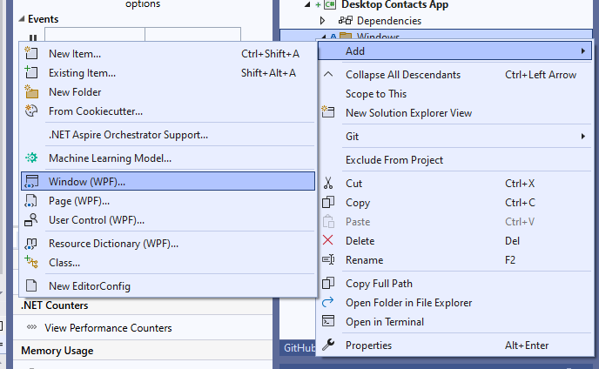
Add new Window (WPF) into a folder: Windows

Slide 2
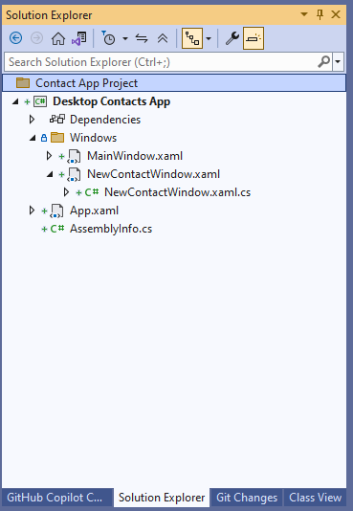

Slide 3
NewContactWindow.xaml
<Grid>
<StackPanel Margin="10">
<TextBox x:Name="nameTextBox"
Margin="0,0,0,5"/>
<TextBox x:Name="emailTextBox"
Margin="0,0,0,5"/>
<TextBox x:Name="phoneTextBox"
Margin="0,0,0,5"/>
<Button Content="Save"
Click="Button_Click"/>
</StackPanel>
</Grid>
Create three textboxes for name, email and phone.
Then add a button to save the contact into the dB.

Slide 4
Few slides elsewhere

Slide 5
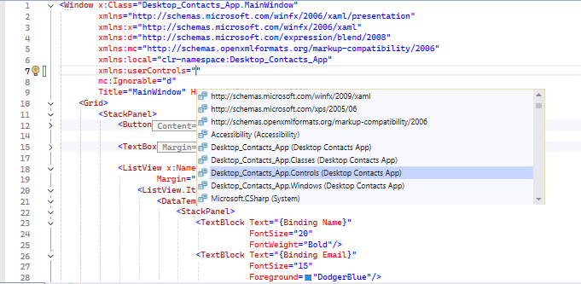
Add user controls to the namespace
xmlns:userControls="clr-namespace:Desktop_Contacts_App.Controls"

Slide 6
<Grid>
<StackPanel>
<Button Content="New contact"
Click="Button_Click"/>
<TextBox Margin="0 5 0 5"
TextChanged="TextBox_TextChanged"/>
<ListView x:Name="contactsListView"
Margin="0, 5, 0, 0">
<ListView.ItemTemplate>
<DataTemplate>
<StackPanel>
<TextBlock Text="{Binding Name}"
FontSize="20"
FontWeight="Bold"/>
<TextBlock Text="{Binding Email}"
FontSize="15"
Foreground="DodgerBlue"/>
<TextBlock Text="{Binding Phone}"
FontSize="15"
FontStyle="Italic"/>
</StackPanel>
</DataTemplate>
</ListView.ItemTemplate>
</ListView>
</StackPanel>
</Grid>
<ListView x:Name="contactsListView"
Margin="0, 5, 0, 0">
<ListView.ItemTemplate>
<DataTemplate>
<userControls:ContactControl Contact="{Binding}"/>
</DataTemplate>
</ListView.ItemTemplate>
</ListView>
An unhandled exception of type 'System.Windows.Markup.XamlParseException' occurred in WindowsBase.dll
A 'Binding' cannot be set on the 'Contact' property of type 'ContactControl'. A 'Binding' can only be set on a DependencyProperty of a DependencyObject.

Slide 7
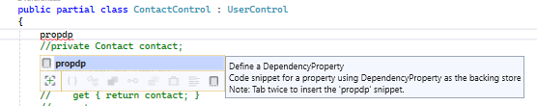
Ctrl + k, c – to comment selected block of code
Ctrl + k, u – uncomment the selected block of code
Create a dependency property by using propdp snippet:
Change to Contact
Change to Contact
public int MyProperty
{
get { return (int)GetValue(MyPropertyProperty); }
set { SetValue(MyPropertyProperty, value); }
}
// Using a DependencyProperty as the backing store for MyProperty. This enables animation, styling, binding, etc...
public static readonly DependencyProperty MyPropertyProperty =
DependencyProperty.Register("MyProperty", typeof(int), typeof(ownerclass), new PropertyMetadata(0));
Will change automatically
ownerClass in this case is: ContactControl

Slide 8
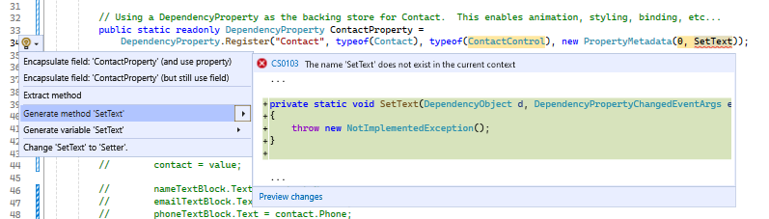
Create a dependency property by using propdp snippet:
public Contact Contact
{
get { return (Contact)GetValue(ContactProperty); }
set { SetValue(ContactProperty, value); }
}
// Using a DependencyProperty as the backing store for Contact. This enables animation, styling, binding, etc...
public static readonly DependencyProperty ContactProperty =
DependencyProperty.Register("Contact", typeof(Contact), typeof(ContactControl), new PropertyMetadata(0, SetText));
private static void SetText(DependencyObject d, DependencyPropertyChangedEventArgs e)
{
throw new NotImplementedException();
}

Slide 9
Set a default value to the old value
public static readonly DependencyProperty ContactProperty =
DependencyProperty.Register("Contact", typeof(Contact), typeof(ContactControl), new PropertyMetadata(new Contact() {Name ="Name LastName", Email="email@domain.com", Phone="(01234) 45678 902" }, SetText));
private static void SetText(DependencyObject d, DependencyPropertyChangedEventArgs e)
{
ContactControl control = (ContactControl)d;
if (control != null)
{
control.nameTextBlock.Text = (e.NewValue as Contact).Name;
control.emailTextBlock.Text = ((Contact)e.NewValue).Email;
control.phoneTextBlock.Text = ((Contact)e.NewValue).Phone;
}
Create a new method for ChangedValue
DependencyObject is of type ContactControl - class
DependencyProperty is the one we just created (type Contact.

Slide 10
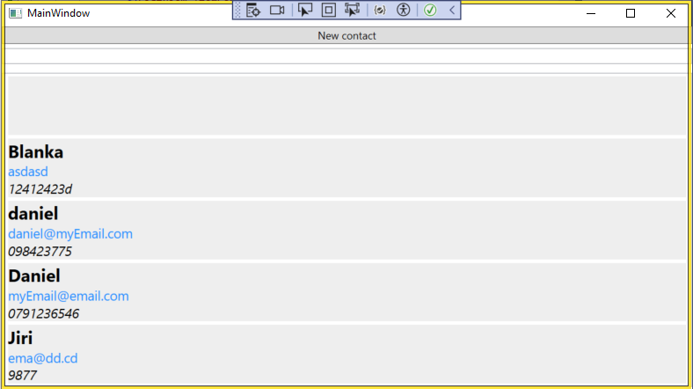
<ListView x:Name="contactsListView"
Margin="0, 5, 0, 0">
<ListView.ItemContainerStyle>
<Style TargetType="ListViewItem">
<Setter Property="HorizontalContentAlignment" Value="Stretch"/>
</Style>
</ListView.ItemContainerStyle>
<ListView.ItemTemplate>
<DataTemplate>
<userControls:ContactControl Contact="{Binding}"/>
</DataTemplate>
</ListView.ItemTemplate>
</ListView>

Slide 11
This will start the new window in center of the MainWindow
public NewContactWindow()
{
InitializeComponent();
Owner = Application.Current.MainWindow;
WindowStartupLocation = WindowStartupLocation.CenterOwner;
}

Slide 12
<Window x:Class="Desktop_Contacts_App.Windows.NewContactWindow"
xmlns="http://schemas.microsoft.com/winfx/2006/xaml/presentation"
xmlns:x="http://schemas.microsoft.com/winfx/2006/xaml"
xmlns:d="http://schemas.microsoft.com/expression/blend/2008"
xmlns:mc="http://schemas.openxmlformats.org/markup-compatibility/2006"
xmlns:local="clr-namespace:Desktop_Contacts_App.Windows"
mc:Ignorable="d"
WindowStyle="None"
ResizeMode="NoResize"
Title="NewContactWindow" Height="450" Width="450">
<Grid>
...
</Grid>
</Window>

